Slide 1

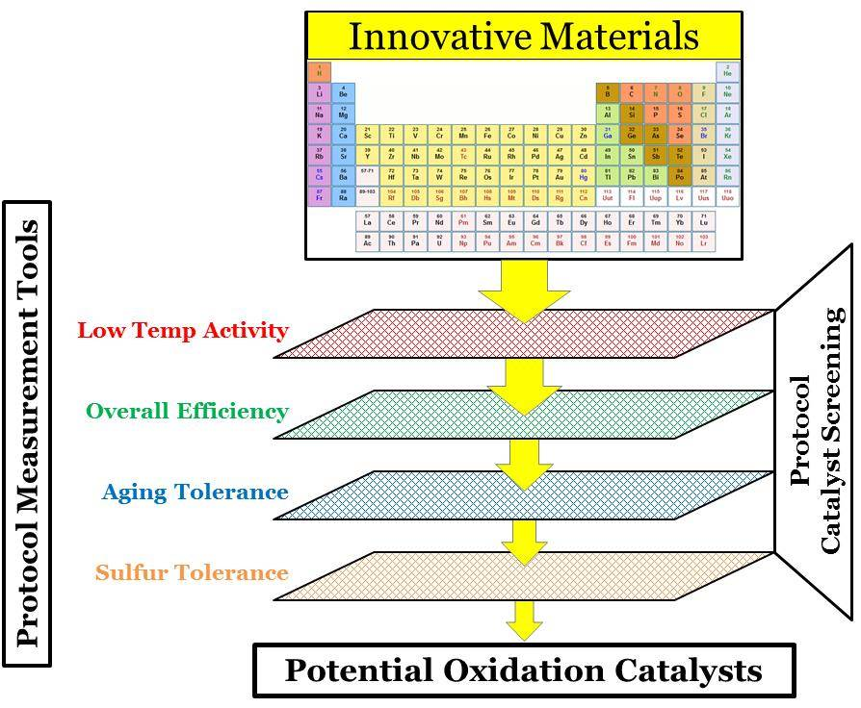
The Advanced Combustion and Emission Control (ACEC) Technical Team
Low Temperature Aftertreatment (LTAT) working group
Including representatives from:
- FCA, Ford, GM, ORNL, PNNL, & DOE
AFTERTREATMENT PROTOCOLS FOR CATALYST CHARACTERIZATION
AND PERFORMANCE EVALUATION
  Why
  Harmonize aftertreatment direction with emerging combustion strategies
  Assist DOE and USDRIVE in evaluation & management of projects
  A pathway for comparative evaluation and benchmarking
  Accelerate pace of catalyst innovation by maximizing value and impact of reported data
Consistent and realistic standardized catalyst test procedures that sufficiently capture a catalyst technology’s performance capability
  Aspirations
  General community consensus
  Consistent with anticipated technologies
  Reproducible, adaptable in various labs
  Be practical and have utility
  Literature citations
Solely intended as guidelines for sharing results of research with the technical community
Meant to be broadly shared in public forum to evaluate and benchmark performance
NOT meant to replace or dictate individual research institute protocols
  Protocol Considerations
  Protocol Structure
Performance
Modeling
  RESEARCH ACTIVITY THE PROTOCOL IS SUPPORTING
  Discovery stage: screening for overall performance, global in nature
  Elementary step-based modeling: isolating each reaction/ads./des. step
  Typically governed by relative maturity of technology
  Will dictate complexity of the test methodologies employed
Conversion
Passive Adsorption
  TYPE OF FUNCTIONALITY BEING STUDIED
  Conversion: Rate (single reaction or class of reactions) versus temperature
  Adsorption: Rate (ads/des) PLUS capacity PLUS desorption temperature
  Adsorption characterization (procedures and equipment) more complex
Functionality
Device
  COMPLEXITY OF THE AFTERTREATMENT PROCESS
  Singular functionality: conversion- or adsorption-based
  Device (e.g., system): often involves multiple functionalities (e.g., NSR)
  Dictates complexity of steps required for adequate characterization
Combustion
Platform
  ENGINE TYPE AND COMBUSTION STRATEGY
  Diesel versus Gasoline
  Stoichiometric versus Lean combustion
  Conventional versus “Advanced” low-temperature combustion (e.g., RCCI)
  STEP 1 – Low-Temperature Oxidation
Easily modified to other CONVERSION-BASED applications
Aging
Poisoning
Performance
Conversion
Functionality
AND
Device
Protocols 3+
to be determined
Additional protocols will be generated as needed based on technology area

