Slide 1
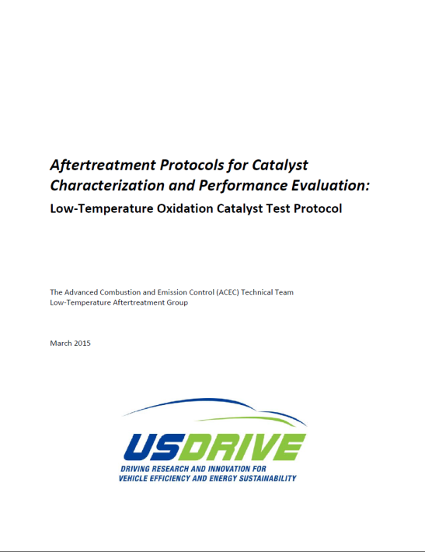
The Advanced Combustion and Emission Control (ACEC) Technical Team
Low Temperature Aftertreatment (LTAT) working group
Including representatives from:
- FCA, Ford, GM, ORNL, PNNL, & DOE
STEP 1
Low-Temperature Oxidation
Low Temperature Aftertreatment (LTAT)
Test Protocol Development
The Protocol is a document that will be distributed via the CLEERS website upon final approval by USDRIVE leadership
Reactor Description
Exhaust Simulation
Core Powder
ANALYTICAL
- [CO], [CO₂], total HC, [NO], [NO₂]
- [N₂O], [NH₃], stoich comb. [O₂]
Frequency of Analysis
Sampling every 2°C
Rate of Response
≤ 15 seconds
TEMPERATURE MEASUREMENT
- catalyst inlet, within catalyst powder, inserted into core
REACTOR BASE-LINING
Ensure reported data dictated solely by material behavior
One-time blank run per application to base-line without catalyst
Quantify recovery of reactive species to ensure fate
Protocol Execution and Reporting
PRE-TREATMENT
20 min @ 600°C
CDC, LTC-(D/G), L-GDI
– Lean [O₂, H₂O, CO₂]
S-GDI
– Neutral [H₂O, CO₂]
De-greening and Aging
All catalysts de-greened prior to protocol execution
De-greening once per sample; pre-treatment prior to each test
Aging/poisoning to occur separately from activity testing
Aged-state unchanged during the course of activity testing
DE-GREENING – 700°C/4 hours
Neutral – gasoline [S-GDI, L-GDI, LTC-G]
Lean – diesel [CDC, LTC-D]
ACTIVITY TESTING
2°C/min 100 – 500°C
30k GHSV (60k option)
Full simulated exhaust
CATALYST AGING – 800°C/50 hours
Diesel
REPORTING
Catalyst Sample Details
Catalyst dimensions (or amount), composition
Core substrate details (e.g., cell density)
Reactor Configuration
Reactor and heating details
Details regarding thermocouple location, chemical analysis, sampling techniques, feed composition, GHSV
Test Conditions
Intended engine application
Procedures used for de-greening, aging and/or poisoning, pre-treating & testing (or reference to protocol)
Test Results/Performance Data
Concentration versus temperature
Conversion efficiency, T50/T90 determination
Diesel w/LNT – 800°C/10 hrs
Gasoline
Time, minutes
Time, seconds
Sulfur Poisoning
POISON – 5 hrs @ 300°C
Full Simulated Exhaust
+ 5 ppm SO₂
PRE-TREATMENT
20 min @ 600°C
ACTIVITY
TESTING

