Slide 1
Modeling the DOC
Richard J. Blint
N₂Kinetics Research
CLEERS Workshop
April 21, 2011

Slide 2
Acknowledgements
Richard Blint
Ed Bissett, Jon Brown Syed Wahiduzzaman
.
William S. Epling and Karishma Irani
Lindsay Deakin and Ty Triplett

Slide 3
Rationale: Aftertreatment modeling has the potential to significantly reduce development costs for vehicle design
Objective: To examine functionality and physical basis for some of the commonly used kinetic terms.

Slide 4
George E. P. Box
“ALL MODELS ARE WRONG BUT SOME ARE USEFUL“

Slide 5
Reaction Mechanism*
CO + 0.5 O₂ => CO₂
C₃H₆ + 4.5 O₂ => 3 CO₂ + 3 H₂O
C₁₂H₂₆ + 18.5 O₂ => 12 CO₂ + 13 H₂O
H₂ + 0.5 O₂ => H₂O
Kinetic Analyses:
SpaciMs GT-Suite (Gamma Technologies)
High flow reactor Fmincon (Matlab)
All kinetic evaluations GT-Suite (Gamma Technologies)
* NO₂ reduction reactions are not considered here

Slide 6
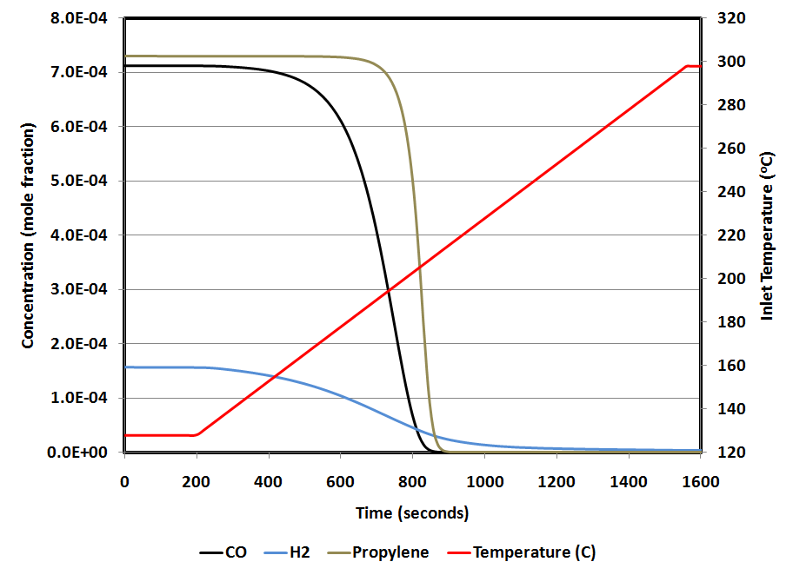
DOC Light-off Predictions at Catalyst Outlet
Based on Sampara-Bissett production catalyst kinetics
CO 50% conversion occurs at approximately ~200 ºC

Slide 7
Evolution of CO Channel Profiles During Light-off
Typical core monolith measurement only occurs at the catalyst outlet
CO channel profiles contain more kinetic information than exit only measurements

Slide 8
Catalyst Kinetics Measurements
Wall support (usually cordierite)
reaction
CO, NO, HC, O₂
CO₂, NO₂, H₂O, O₂
reaction
Thin washcoat (PGM, promoter and alumina)
Most catalyst kinetics are developed from:
Exit only measurements
Pointwise measurements along the channel (SpaciMs)
Kinetics can also be developed from:

Slide 9
High Flow Rate Reactor
Air
REACTANT GAS MANIFOLD
H O
Air/O
2
2
MFC
N
2
MFC
Heated Lines (190 ºC)
O₂
NO
MFC
C₃H₆
MFC
Sample inlet
CO
MFC
TC
TC
H
Catalyst 0.505” length x 0.713” diameter
2
MFC
Sample outlet
CO
MFC
2
TC
FTIR SPECTROMETER
VENT
H SENSE
FID
Q7000
Capable of space velocities up to 2,000,000 hr⁻¹
Notes:
9

Slide 10
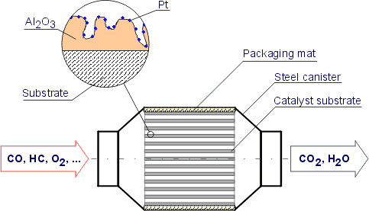
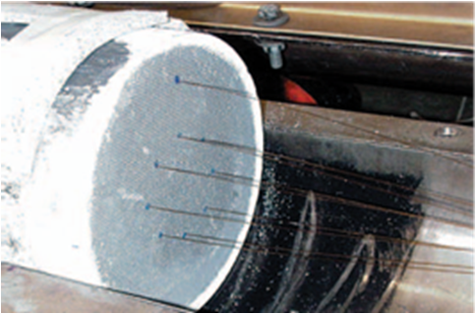
SpaciMs Measurements
PGM

Slide 11
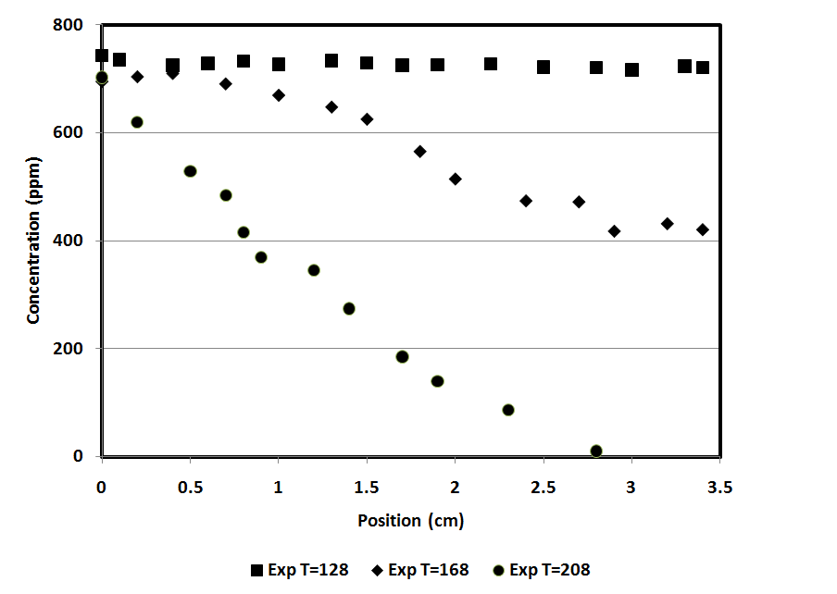
CO SpaciMs Measurements
CO oxidation initiates at low temperature and progresses toward catalyst inlet with increasing inlet temperatures
CO exit concentrations zero before 200 ºC

Slide 12
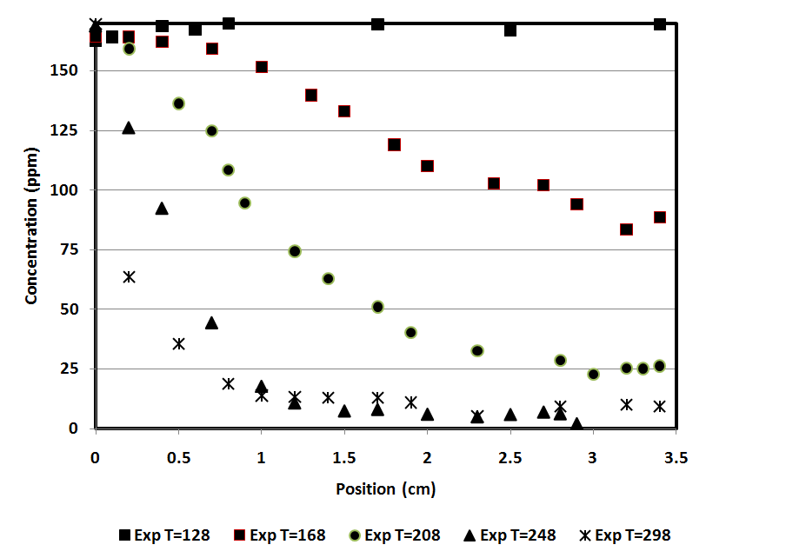
H₂ SpaciMs Measurements
H₂ oxidation initiates early similarly to the CO oxidation and also progresses toward the inlet with increasing inlet temperature
H₂ concentrations monotonically decrease with increasing inlet temperature

Slide 13
H₂/CO Kinetic Analysis
H₂ is rarely measured as an engine out exhaust species
Often engine out hydrogen emissions are estimated to be approximately 1/3 of the CO emissions
Measurements of engine out hydrogen for gasoline engines have reported maximum H₂ volume percent concentrations in the range between 0.3% to 3%
Common modeling approach, H₂ rates set to be the same as the CO rates (Oh and Cavendish, Ind. Eng. Chem. Res., 21, pg 29, 7993-8003, 1982)
Sun et al. studied the oxidation of CO and H₂ over a cordierite monolith wash-coated with Pt/Al₂O₃ and suggested that the activation energy for H₂ oxidation is lower than for CO oxidation.

Slide 14
Kinetic equations
Rate (r_{i}) of consumption of H₂, CO and hydrocarbons in units of concentration/second
where
k_{i} is the rate constant (often known as the turn-over number, A_{i} is the prefactor, E_{a} is the activation energy r), C_{s,i} are the species concentrations, G is the inhibition term and SD is the site density.
The turn over rate is characteristic of the catalytic coating.
The active site density is characteristic of the catalyst loading and aging.

Slide 15
Objective Function for High Flow Rate Reactor
nsp = number of species
n_{T} = number of points
n_{j} is the number of species

Slide 16
SpaciMs Reaction Constant Optimization
12 possible independent variables and 16 total with NO oxidation reaction
Optimization uses the GT-Power DOE solver
Typical runs varied up to 4 variables at a time
Objective functions are based on the spatial concentration measurements
or
where T_{inlet} is the gas inlet temperature and α(12) is any of the reaction parameters

Slide 17
Oxidation Kinetic Rate Studies
Catalyst | CO (ppm) | H2 (ppm) | NO (ppm) | HC (ppm) | # of experiments | Exp method | Ref
1 (Prod) | 30-3000 | 70-700 | 4-400 | 0-2000 ppm | 25 | Hi Flow reactor | 1
2 (PtPd DOC) | 0-730 | 0-160 | 0-130 | 0-1100 | 61 (CO 45) | SpaciMs | 2
3 (Pt DOC) | 30-900 | 70-200 | 100-400 | 20-2000 | 25 | Hi Flow reactor | 3
4 (TWC ) | 25-25000 | 80-8000 | 150-1500 | 20-2000 | 25 | Hi Flow reactor | 4
Sampara, et al., Ind. Eng. Chem. Res., 46, pg 7993-8003, 2007
Epling, Irani and Blint, Topics in Catalysis, 52, 1856-1859, 2009 ; Irani, Master’s thesis, University of Waterloo, 2009
Sampara et. al, Ind. Eng. Chem. Res., 47, pg 311-322, 2008
Deakin, et al., to be submitted, 2011

Slide 18
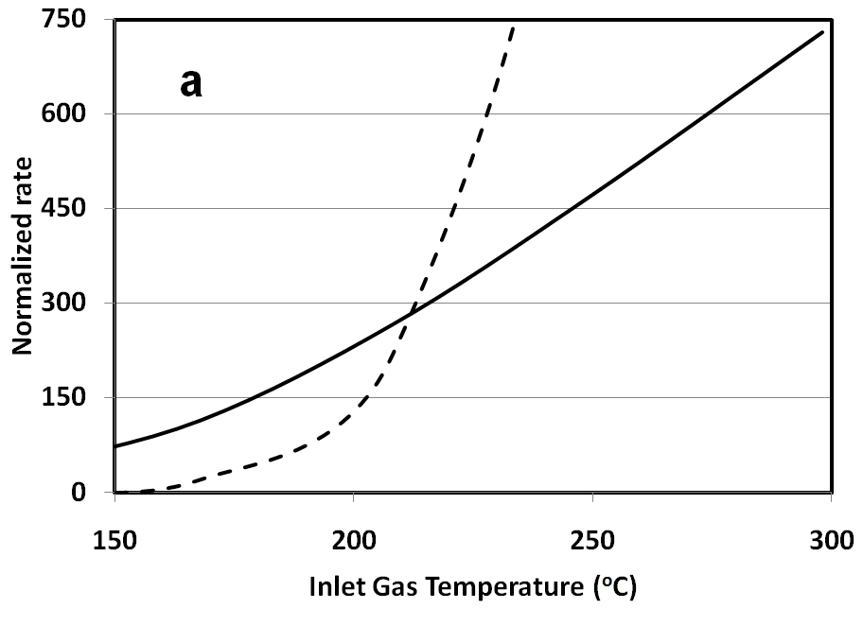
Rate Constant Temperature Dependence
Catalyst 1: Production DOC
CO rate constant
H₂ rate constant
Rate constant intercept 214 ºC
Rate constants through the inhibition term are dependent on the instantaneous gas concentrations

Slide 19
Activation Energies
Catalyst | Ea (CO, kJ) | Ea (H₂, kJ) | Source
Pt DOC | 22.1 | 30.3 | Sampara, et al., Ind. Eng. Chem. Res., 46, 7993-8003, 2007
Prod DOC | 81.3 | 15.3 | Sampara et. al, Ind. Eng. Chem. Res., 47, 311-322, 2008
GMT-800 | 65.2 | 18.6 | Deakin, et. al (manuscript)
PtPd DOC | 79.1 (72 isothermal) | 14.4 | SpaciMS fit

Slide 20
Pt:Pd Effect
PtPd DOC light-off measurements show lower light-off temperatures compared to Pt only and Pd only (Chang, et al, SAE 2011-01-1134)
PtPd mixtures show lowest light-off and similar CO and H₂ activation energies
PtRh shows similar CO and H₂ activation energies
Pt DOC only activation energies are markedly different

Slide 21
Seminal Paper on Global Catalyst Kinetic Rate Forms
Sterling E. Voltz, Charles R. Morgan, David Liederman, Solomon M. Jacob,"Kinetic study of carbon monoxide and propylene oxidation on platinum catalysts", Ind. Eng. Chem. Prod. Res. Dev., 1973, 12 (4), pp 294
Introduced the inhibition (“resistance”) function to describe the loss of reactivity on precious metal (PGM) active sites due to coverage by CO, hydrocarbon and NO.
Measurements done on platinum coated alumina spheres (pellets).
Showed inhibition effects on CO and propylene oxidation
Used the same inhibition function parameters for both carbon monoxide and propylene oxidation

Slide 22
Inhibition equations
where G is the inhibition term C_{s,i} are the species concentrations and K _{i} is
where A_{i} is the prefactor, E_{a} is the activation energy and i indicates the species.
Propylene inhibition term not always included because it was found to be insignificant under these conditions.

Slide 23
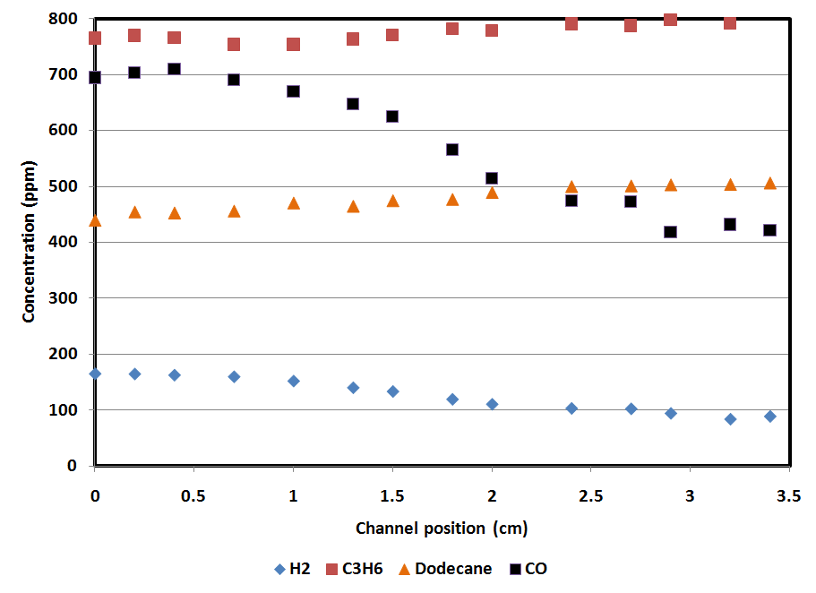
Exp Profiles (Constant Flow) ~40 ⁰C Before Light-off
No measured HC consumption
Initial CO and H2 consumption

Slide 24
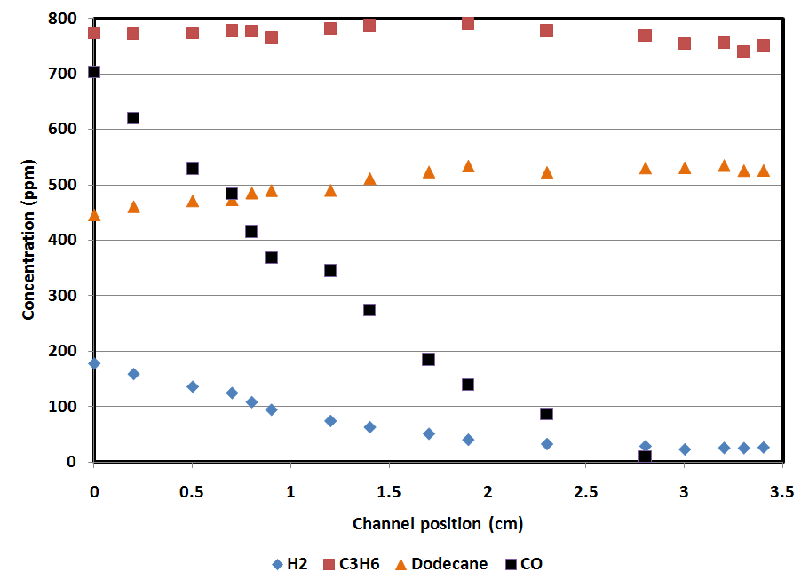
Exp Profiles (Constant Flow) at Approximately Light-off
Still no measured HC consumption

Slide 25
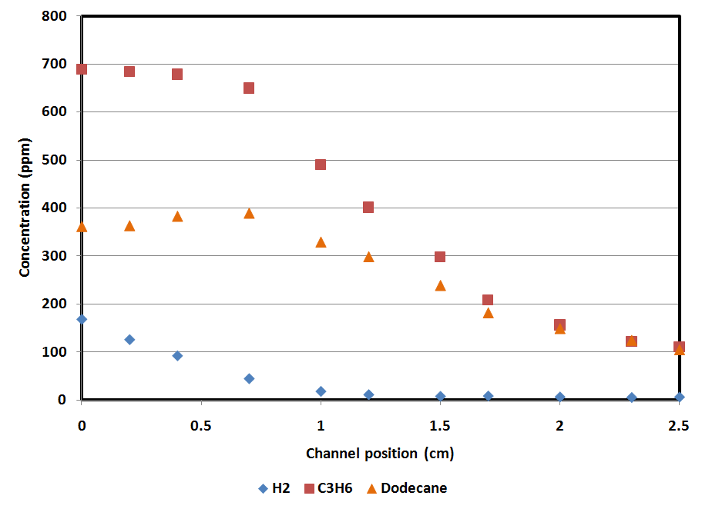
Exp Profiles (Constant Flow) at ~40 ºC After Light-off
Appreciable HC consumption
Hydrocarbon decay measured well after CO light-off

Slide 26
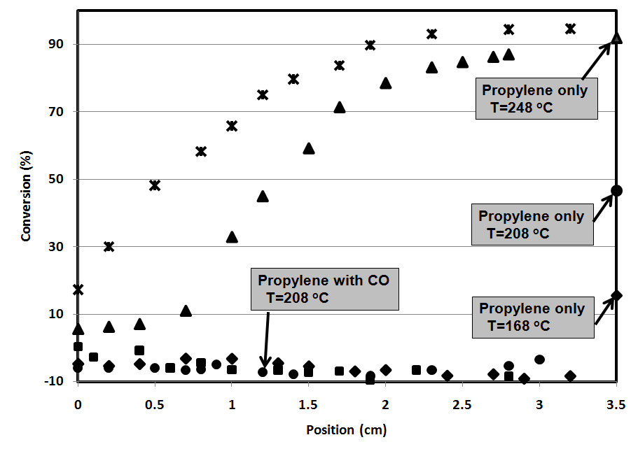
Propylene Oxidation (SpaciMs measurements)
Propylene oxidation with CO does not start until about 248 ºC
Propylene exit conversion 50% at 208 ºC

Slide 27
Conceptualized Catalytic Surface
-C-O
-C-O
-C-O
-C-O
-C-O
-C-O
-C-O
-C-O
-C-O
-C-O
-C-O
-C-O
-C-O
-C-O
-C-O
-C-O
-C-O
-C-O
-C-O
-C-O
-C-O
-C-O
-C-O
-C-O
-C-O
-C-O
-C-O
-C-O
-C-O
-C-O
-C-O
-C-O
CO is strongest absorbate for a PGM surface

Slide 28
Conceptualized Reactive Surface
-C-O
-C-O
-C-O
-C-O
-C-O
-C-O
-C-O
-C-O
-C-O
-O
-C-O
-C-O
-O
-C-O
-C-O
-C-O
-C-O
-C-O
-C-O
-C-O
-C-O
-C-O
-C-O
-C-O
-C-O
-O
-C-O
-C-O
-C-O
-C-O
-C-O
-O
-C-O
-C-O
-C-O
-C-O
Sparse absorption of oxygen provides the oxidant for the CO, H₂ and HC

Slide 29
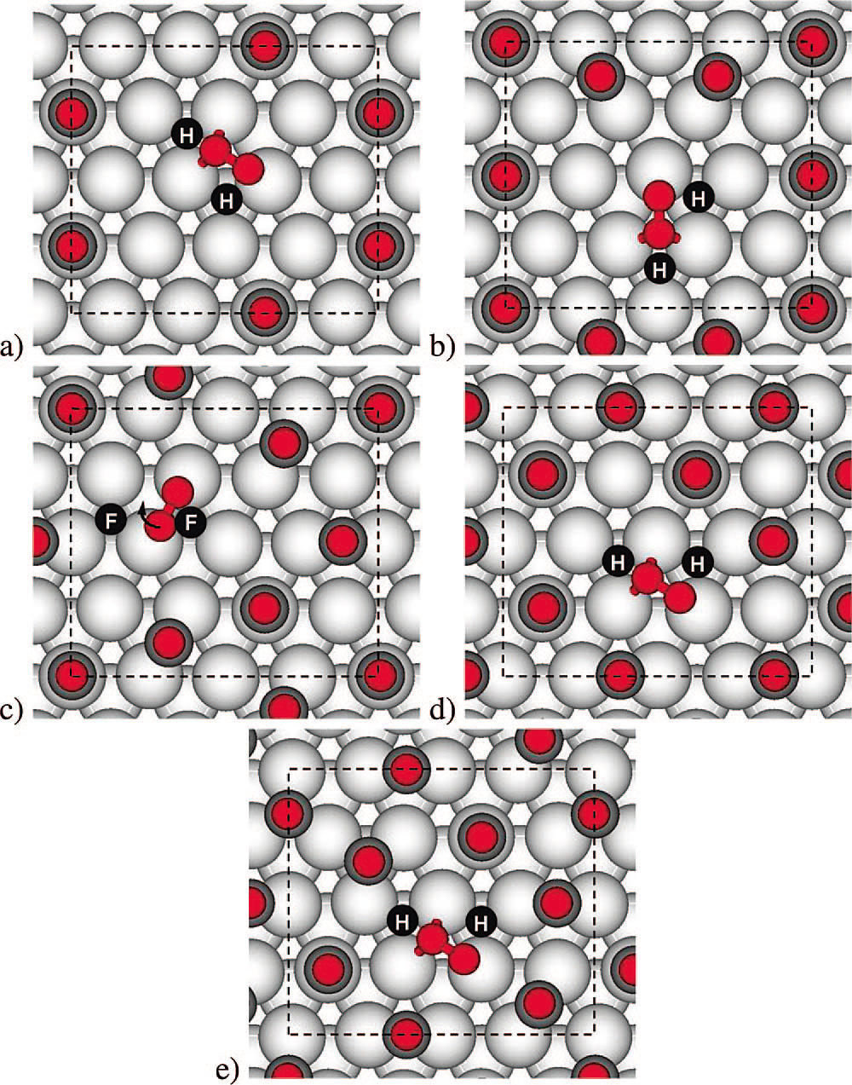
DFT Calculations of Oxygen States on CO adsorbed Pt (111) surface
O₂ molecular precursor states with different CO coverage:
(a) 0.19 ML, (b) 0.25 ML, (c) 0.31 ML, (d) 0.38 ML, and (e) 0.44
ML. Light gray circles represent Pt atoms, dark gray circles represent
C atoms, and small red circles represent O atoms. Black dots with H/F
indicate the position of the dissociated atomic oxygen in either hcp
(H) or fcc (F) positions. The arrow in panel c indicates that the oxygen
rotates from t-b-t to t-h-b before dissociation.
The energies of O₂ precursor state, transition state, and dissociated oxygen atoms all become less stable with increasing CO coverage which indicates a CO self-inhibition
CO-Coverage-Dependent Oxygen Dissociation on Pt(111) Surface, Bin Shan,*,† Neeti Kapur,† Jangsuk Hyun,† Ligen Wang,† John B Nicholas,† and Kyeongjae Cho, J. Phys. Chem. C 2009, 113, 710–715

Slide 30
H-H
H-H
-C-O
-C-O
-C-O
-C-O
-C-O
-C-O
-C-O
-C-O
-C-O
-O
-C-O
-C-O
-O
-C-O
-C-O
-C-O
-C-O
-C-O
-C-O
-C-O
-C-O
-C-O
-C-O
-C-O
-C-O
-O
-C-O
-C-O
-C-O
-C-O
-C-O
-O
-C-O
-C-O
-C-O
-C-O

Slide 31
H₂-C-C-H-C-H₃
H₂-C-C-H-C-H₃
-C-O
-C-O
-C-O
-C-O
-C-O
-C-O
-C-O
-C-O
-C-O
-O
-C-O
-C-O
-O
-C-O
-C-O
-C-O
-C-O
-C-O
-C-O
-C-O
-C-O
-C-O
-C-O
-C-O
-C-O
-O
-C-O
-C-O
-C-O
-C-O
-C-O
-O
-C-O
-C-O
-C-O
-C-O

Slide 32
CO Inhibition Terms
CO (self-inhibition)
Voltz found a significant effect
At these conditions the catalyst kinetics evaluated here have small effects due to the CO concentrations
Inhibition optimization essentially zeros out the CO self inhibition term
H₂
SpaciMs profiles show no effect from the CO concentration as strong as the hydrocarbon sensitivity
C₃H₆
Strongest dependence on the CO concentration over 30 times greater than that found with H₂
C₁₂H₂₆
Dependence on the CO concentration over 15 times greater than that found with H₂

Slide 33
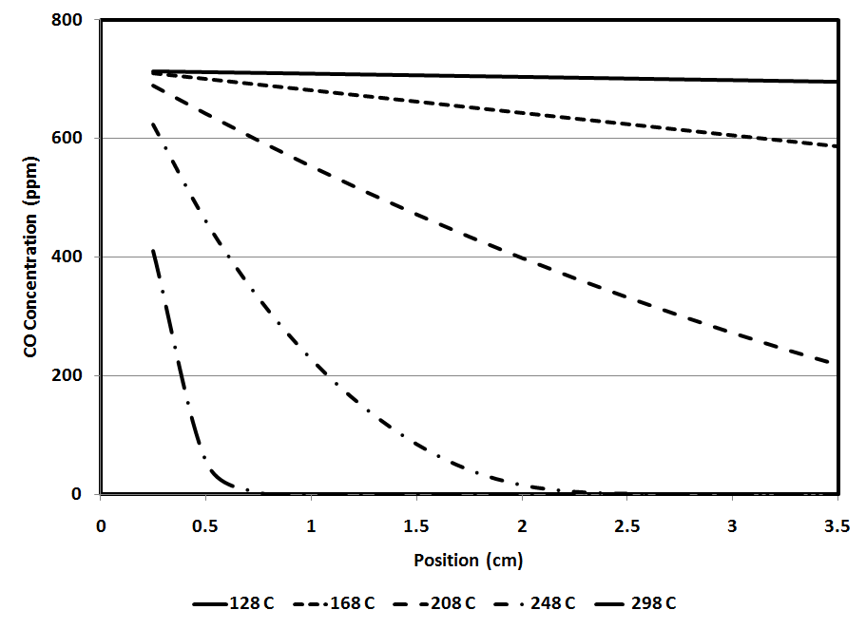
CO Calculated Spatial Profiles
For temperatures above 200 ºC the CO concentration is effectively zero for increasing fractions of the catalyst channel

Slide 34
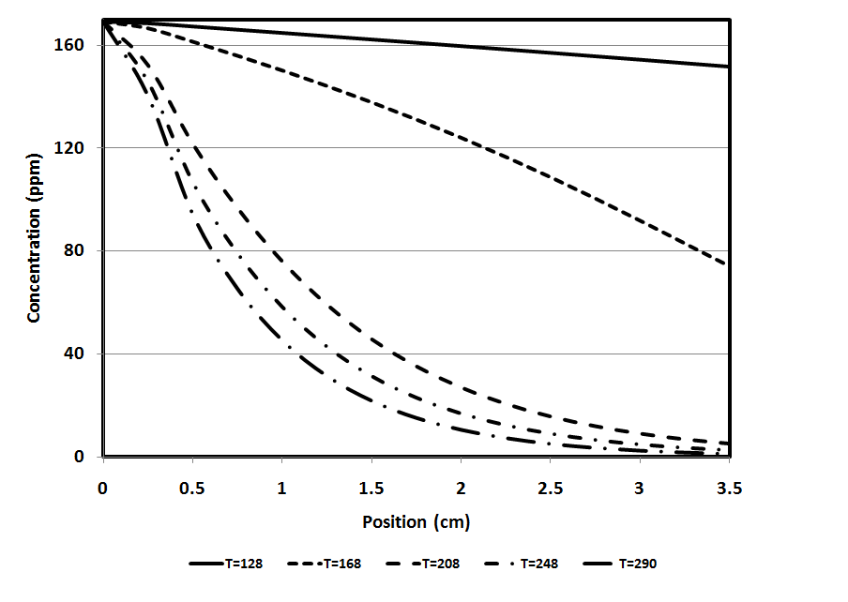
H₂ Calculated Spatial Profiles
For temperatures above 200 ºC the CO concentration is effectively zero for increasing fractions of the catalyst channel

Slide 35
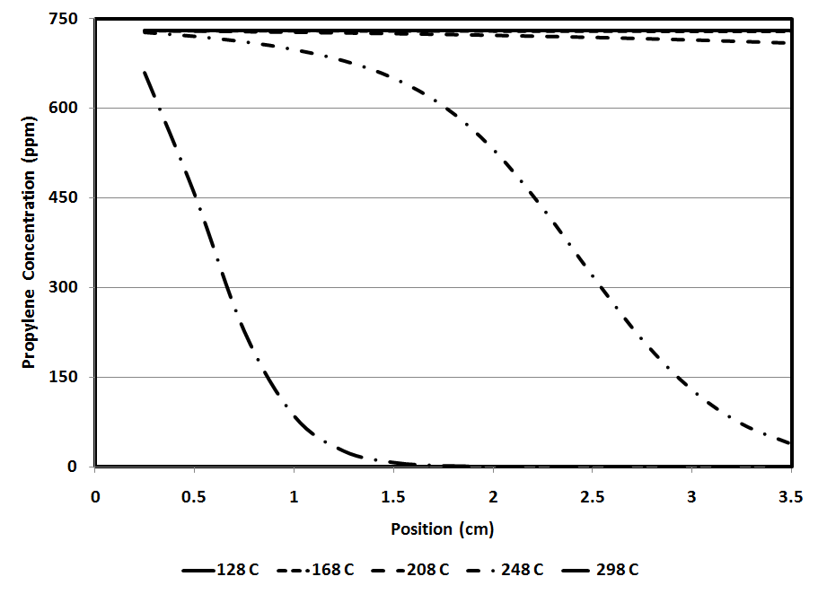
C₃H₆ Calculated Spatial Profiles
Optimizing the CO inhibition function for propylene oxidation based on the spatial profiles of both CO and propylene restricts the propylene decay to temperatures above 208 ºC

Slide 36
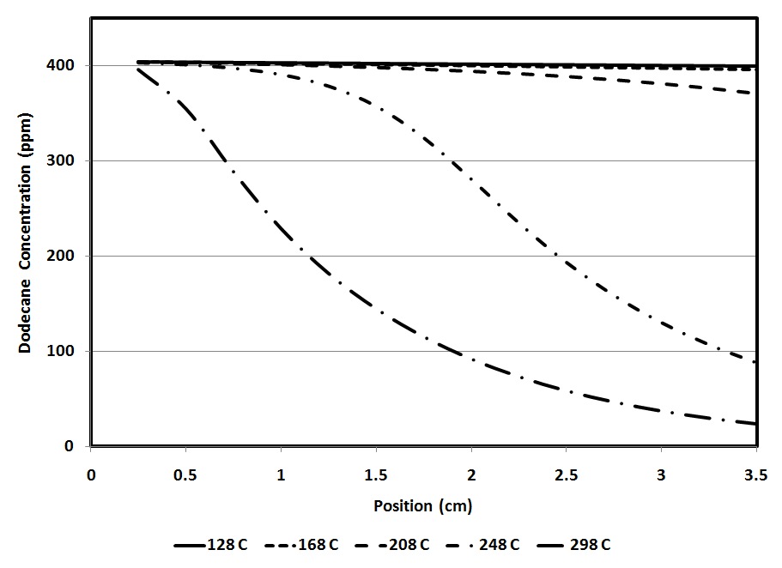
C₁₂H₂₆ Calculated Spatial Profiles
To predict the dodecane profiles the CO inhibition function needs to be approximately half that used for propylene oxidation

Slide 37
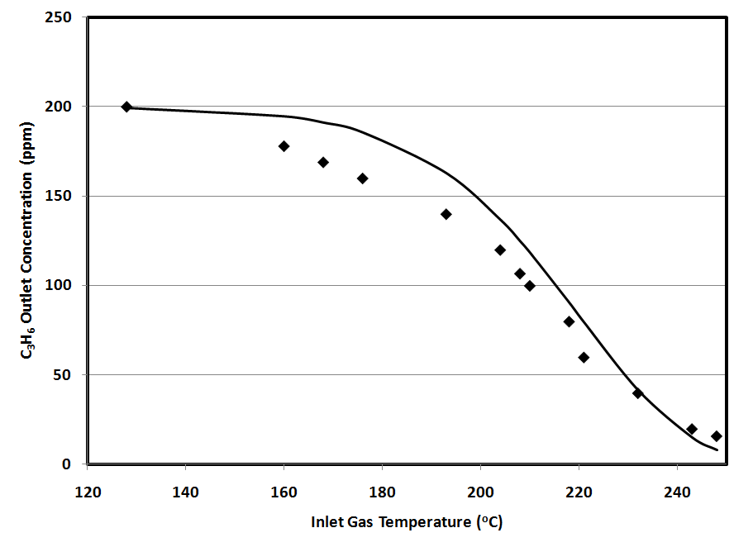
Propylene Only Oxidation
H₂ oxidation initiates early similarly to the CO oxidation and also progresses toward the inlet with increasing inlet temperature
H₂ concentrations monotonically decrease with increasing inlet temperature

Slide 38
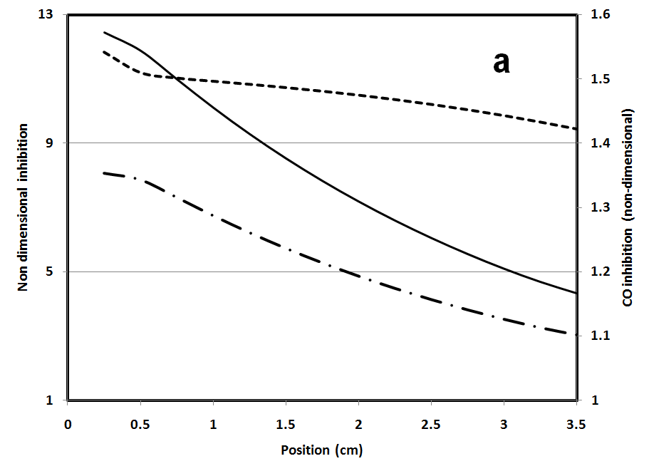
Spatial Dependence of Inhibition Terms
Catalyst 1: Production DOC 128 ºC Total inhibition (solid curve) is the product of the NO inhibition (dash-dot) and the CO inhibition (short dashed line with values on right axis) terms

Slide 39
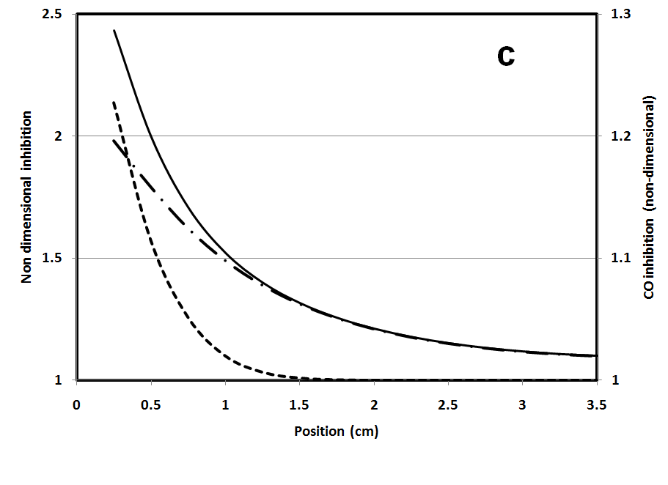
Spatial Dependence of Inhibition Terms
Catalyst 1: Production DOC 208 ºC Total inhibition (solid curve) is the product of the NO inhibition (dash-dot) and the CO inhibition (short dashed line with values on right axis) terms

Slide 40
Summary and Conclusions
H₂ and CO kinetics
Activation energies for these reactions are similar for three Pt-PGM alloys
These activation energies provide a rational basis for selecting values for “new” catalyst systems
Global kinetics can describe species profiles along the DOC monolith channel
Global kinetic rate constants can be developed from SpaciMS measurements
SpaciMs measurements show:
In these measurements hydrocarbon consumption occurs only after the CO has been consumed
The “fast”, low temperature hydrogen oxidation rates do not result in complete oxidation of the hydrogen at the inlet of the channel
CO inhibition term, it appears as if they cannot be the same value for all species:
optimizes to negligible for CO rate on the PtPd DOC if done separately
CO inhibition for H₂ is appreciable but small
CO inhibition for hydrocarbons is large and has a very visible impact
Activation energies for propylene and dodecane are quite different, implying that generalizations on the activation energies for families of hydrocarbons are not yet justified.
GT-Power provides a flexible program for both predicting these profiles and the tools to optimize the rate constants

