Slide 1
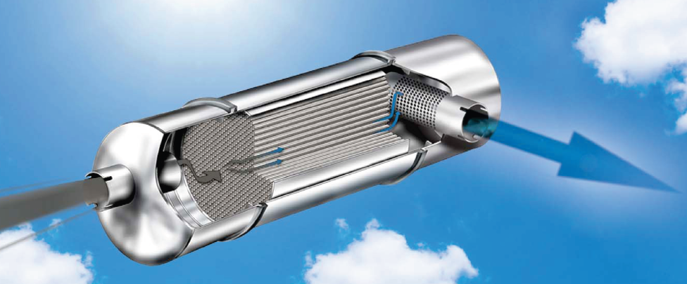


A Detailed Microkinetic Model for Diesel Engine Emissions Oxidation on Pt DOC
1
Hom Sharma
Ashish Mhadeshwar
Department of Chemical, Materials and Biomolecular Engineering
University of Connecticut , Storrs, CT
1 May 2012
1. http://enginecontrolsystems.com/images/homepage/ECSbroch_final.pdf

Slide 2
Outline
Background : Diesel engine emissions
Emissions oxidation microkinetic modeling
  Mechanism development
  Kinetic parameter extraction
  Model performance
Model limitations
Future work
  Model expansion to larger emissions
  DOC deactivation due to sulfation

Slide 3
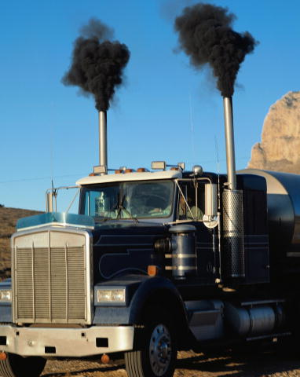
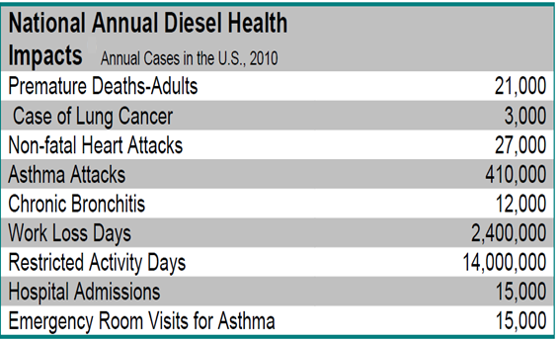
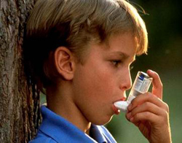
Diesel emissions: Health and environmental impact
CO (PPM) | HC (PPM) | NO_{X} (PPM) | SO_{X} (PPM) | DPM¹ (g/cm³ )
5 – 1500 | 20 – 400 | 50 – 2500 | 10 – 150 | 0.1 – 0.25
2
3
4
1.http://www.nett.ca/faq/diesel-1.html
2.http://en.wikipedia.org/wiki/File:Diesel-smoke.jpg
3.http://www.catf.us/diesel/problems/
4.http://www.fleetadvantage.net/effectsOfDiesel.cfm

Slide 4
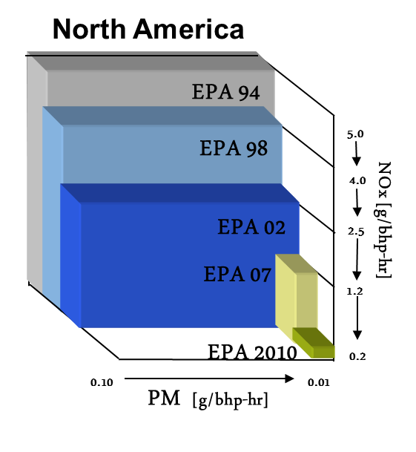
Diesel engine emissions regulations
U.S. Clean Air Act Amendments of 1970:
a major shift in the federal government's role in air pollution control
Heavy-duty highway engines
Emissions regulations are getting increasingly stringent.
NOx: 0.2 g/bhp-hr
PM: 0.01 g/bhp-hr
NMHC: 0.14 g/bhp-hr

Slide 5
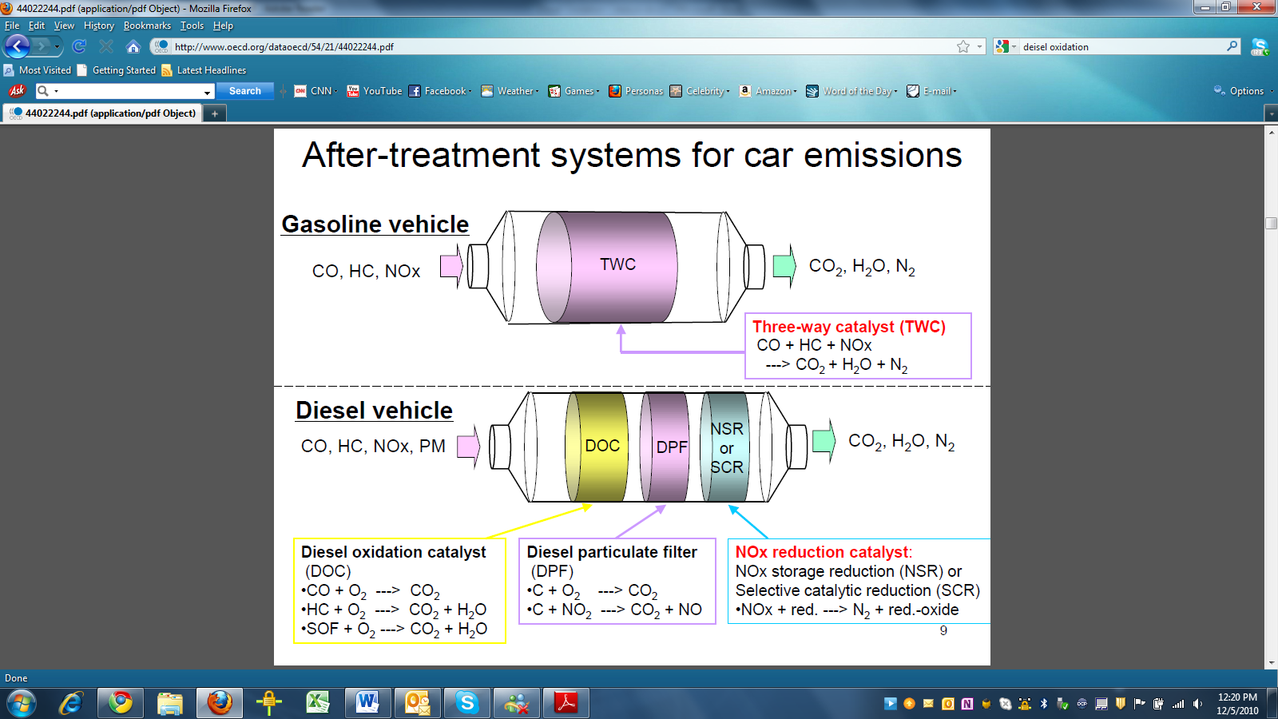
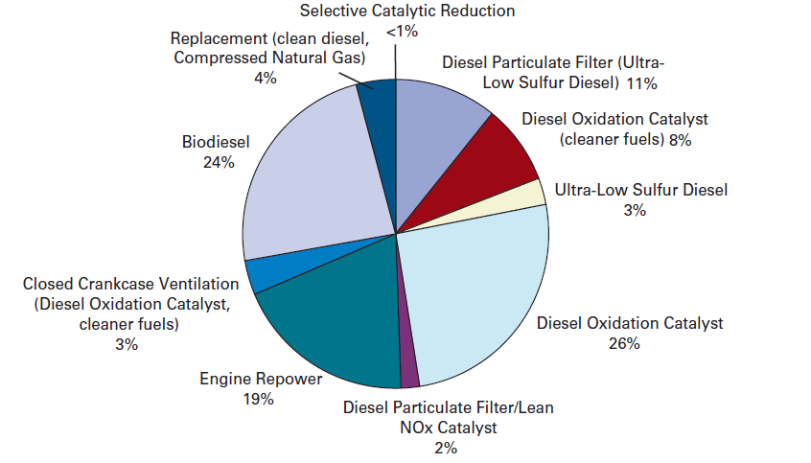
Diesel engine emissions aftertreatment system
Technologies to reduce Diesel engine emissions¹
NO:NO₂ ratio
Oxidation of byproducts:
CO, HCN, CH₂O, NH₃
1.http://www.epa.gov/cleandiesel/documents/420r06009.pdf

Slide 6
Motivation for DOC modeling:
Pt/Pd based DOCs are expensive.
Fundamental understanding of DOC kinetics for emissions oxidation is necessary.
A detailed microkinetic model for DOC operation can be a good starting point for understanding DOC deactivation.
CO
NO
CH₂O
NH₃
HCN
Pt
DOC
Model

Slide 7
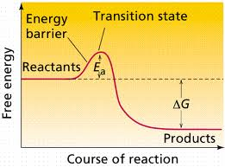

Key steps in microkinetic modeling
CH₂O(g)
CH₂O*
HCO*
CO*
CO₂*
Mechanism development
H*
OH*
H₂O*
A: Pre-exponential
E_{a}: Activation energy
Q: Binding energy
BI: Bond index
Parameter estimation
Model performance

Slide 8
Steps in microkinetic modeling for emissions oxidation
Mechanism Development
Parameter Estimation
Model Performance

Slide 9
Mechanism development : 5 oxidation chemistries
CHEMISTRY | REACTIONS
CO Oxidation | CO +1/2 O₂ → CO₂
NO Oxidation | NO +1/2 O₂ → NO₂
HCN Oxidation | HCN + O₂ → CO, CO₂, NO_{x}, H₂O
NH₃ Oxidation | NH₃ +O₂→ NO_{x}, H₂O, N₂
CH₂O Oxidation | CH₂O +O₂ → CO₂, H₂O
Gas phase chemistry:
(GRI)¹
Surface chemistry:
This work
21 Surface species
130 reactions
O₂(g)
O*
HCN(g)
HCN*
+O*
CN *
+O*
CO*
+O*
CO₂*
CO₂(g)
OH*
NO*
NO₂*
NO₂(g)
N*
N₂O*
N₂O(g)
H₂O*
H₂O(g)
N₂(g)
http://www.me.berkeley.edu/gri-mech

Slide 10
Steps in microkinetic modeling for emissions oxidation
Mechanism Development
Parameter Estimation
Model Performance

Slide 11
Parameter estimation for the microkinetic model
Pre-exponential factors
Binding energies
A
TST¹
Desorption: 10¹³ s⁻¹
Surface reaction:
10¹¹ s⁻¹
Literature
Sticking coefficients
Q
UBI-QEP²
DFT
TPD
Activation energies
Bond indices
Adsorbate interactions
E
UBI-QEP
TPR
α
TPD
DFT
BI
UBI-QEP
0.5
1. Dumesic, J. et al., The Microkinetics of Heterogeneous Catalysis,1998
2. Shustorovich, E. and Sellers, H., Surface Science Reports, 1998

Slide 12
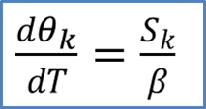
Parameter extraction from surface science experiments
Experimental data from literature
TPD/TPR on Pt
1D reactor model
Kinetic Parameters
TPD
TPR
Binding energies (Q)
Adsorbate interactions (α)
Bond indices (BI)
Activation Energies (Ea)
H₂, O₂, CO, CO₂, N₂, NO, NO₂, H₂O, CH₂O, NH₃, and HCN
CO, NO, CH₂O, HCN, and NH₃

Slide 13
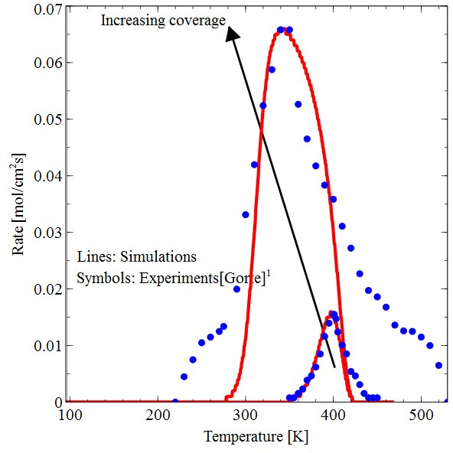
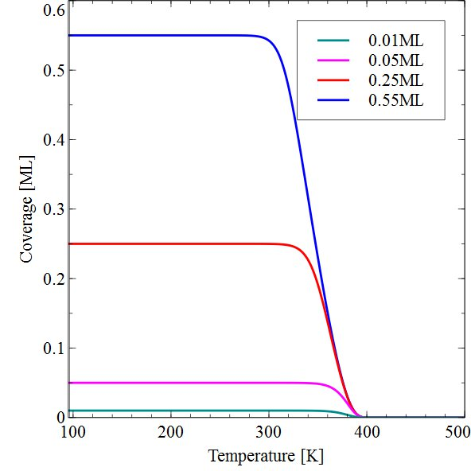
Parameter extraction from TPD experiments
NO TPD on Pt(111)
θ^{in}_{NO} = 0.55 ML
0.05 ML
β = 10 K/s
Extracted parameters:
Binding Energy
Adsorbate interactions
Q_{NO} = 29.5 – 9.7θ_{NO} kcal/mol
Literature range for Q_{NO}: 18-43 kcal/mol

Slide 14
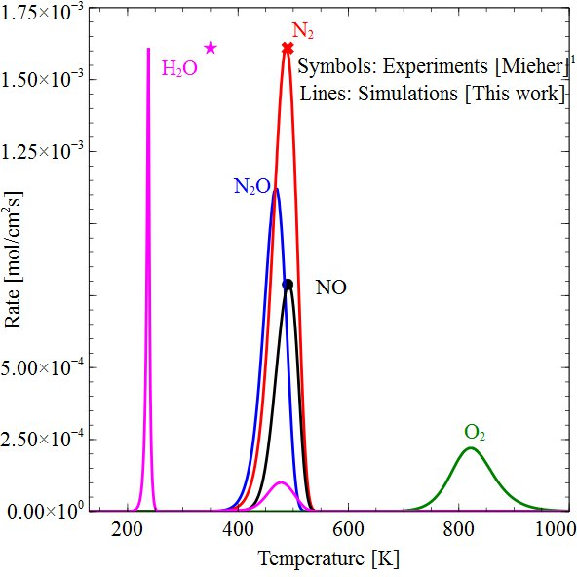
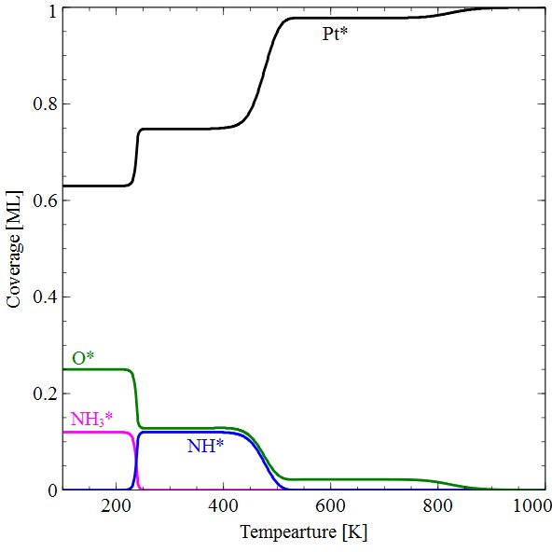
Parameter extraction from TPR experiments
NH₃ TPR
θ^{in}_{NH3} = 0.12 ML
θ^{in}_{O} = 0.25 ML
β = 2 K/s
Extracted parameters:
Bond indices
Activation energies
NH₃*+O* → NH₂*+OH*
NH₂*+O*→ NH*+OH*
NH₃*+OH* → NH₂*+H₂O*
NH*+O*→ N*+OH*
NH*+O* → NO*+H*
2NO* → N₂O*+O*
2O*→ O₂+2*
W. Ho and W. Mieher, Solid State Physics, 1995

Slide 15
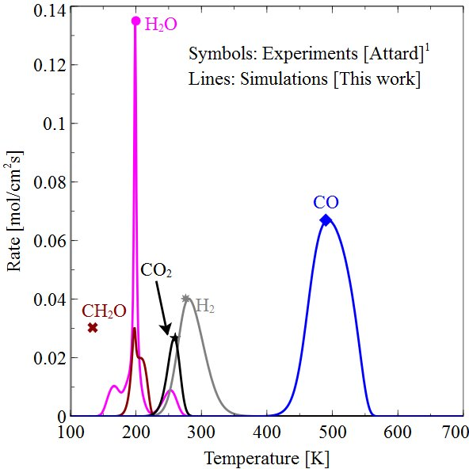
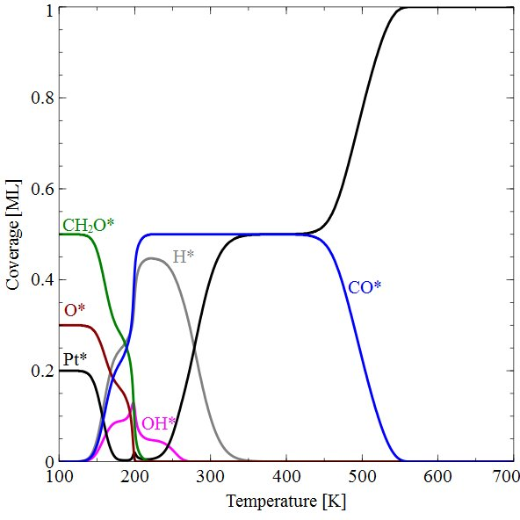
Mechanism validation against TPR experiments
CH₂O TPR
CH₂O*+ * → HCO*+ H*
HCO*+O*→ CO*+OH*
HCO*+OH*→ H₂O*+CO*
H₂O* → H₂O+*
CO*+OH* → CO₂*+H*
OH*+H* → H₂O*+*
2H* → H₂+2*
CO* → CO+*
θ^{in}_{CH2O} = 0.5 ML
θ^{in}_{O} = 0.3 ML
β = 10 K/s
G.A. Attard, H.D. Ebert, and R. Parsons, Surface Science, 1990,
Notes:
Blank slide for drafting a body slide.

Slide 16
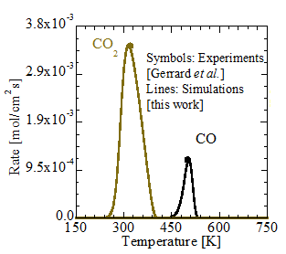
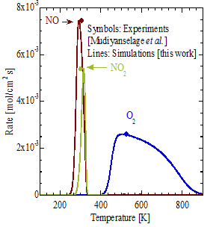
Additional examples
N₂ TPD
H₂ TPD
CO TPR
NO TPR
CO TPD

Slide 17
Steps in microkinetic modeling for emissions oxidation
Mechanism Development
Parameter Estimation
Model Performance

Slide 18
Mechanism/model performance:
Kinetic parameters are extracted from UHV TPD/R conditions.
DOC operating conditions are significantly different:
  Atmospheric pressure
  High flow rates
  Low emissions concentrations (ppm)
  Monoliths
  Fixed beds (literature experiments)
Mechanism/model performance should be tested under practically relevant conditions.
Isothermal plug flow reactor modeling at steady state.

Slide 19
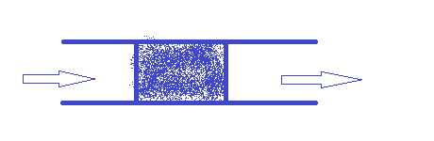

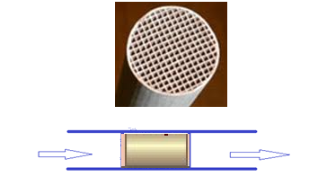
Model details
Fixed beds and Monoliths (PFR)
Oxidation of CO, NO, CH₂O, HCN, NH₃
Governing Equations for PFR:
Mass balance for gas species:
Surface species rate:
Site balance:
Steady state
Isothermal
Fixed Bed
Inlet
outlet
Monolith
S_{k} = 0
∑θ_{k} = 1
Inlet
outlet

Slide 20
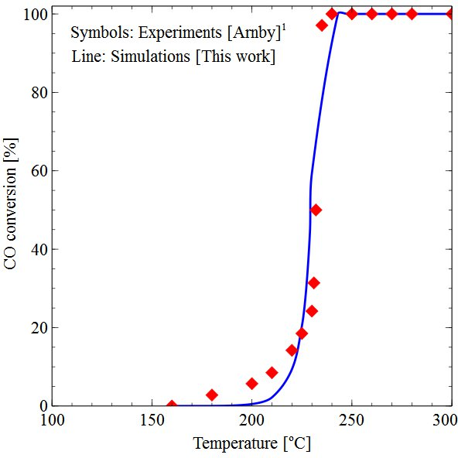
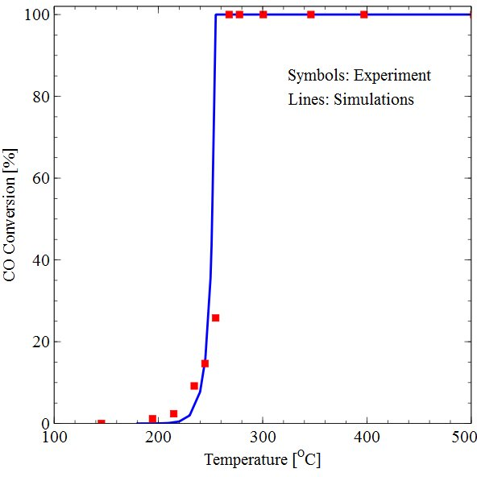
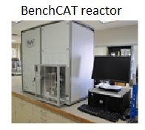
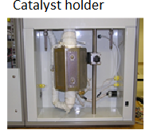
Model performance: CO oxidation on Pt
Literature experiments
Our experiments
Pt/ZnO monolith:
1% CO, 10% O₂,
89% Ar
Total flow = 50 sccm
SV = 30000 h⁻¹
A/V = 30 cm⁻¹
Monolith:
1% CO
10% O₂
SV = 17000 h⁻¹
A/V = 32.6 cm⁻¹
O*
CO*
CO₂*
Experiments: K. Arnby, Journal of Catalysis, 2004.

Slide 21

Model performance: NO oxidation on Pt
Before thermodynamic consistency
After thermodynamic consistency
O*
NO*
NO₂*
Experiments: D. Bhatia, R.W. McCabe, M.P. Harold, and V. Balakotaiah, Journal of Catalysis, 2009

Slide 22
Model validation: NO oxidation on Pt
Experiments: Crocoll, M, S Kureti, and W Weisweiler. Journal of Catalysis 229.2 (2005): 480-489.

Slide 23
Model performance: CH₂O oxidation on Pt
a. Experiments: C. Zhang, H. He, and K. Tanaka, Catalysis Communications, 2005
b. Experiments: J. Peng and S. Wang, Applied Catalysis B: Environmental, 2007

Slide 24
CH₂O oxidation on Pt: Reaction path analysis
O₂(g)
O*
CH₂O(g)
CH₂O*
+O*
HCO*
+O*
CO*
+O*
CO₂*
CO₂(g)
+CO*
OH*
-H*
H₂O*
H₂O(g)

Slide 25
Model performance: HCN oxidation on Pt
Experiments: H. Zhao, R. Tonkyn, S. Barlow, B. Koel, and C. Peden, Applied Catalysis B: Environmental,. 2006

Slide 26
HCN oxidation on Pt: Reaction path analysis
O₂(g)
O*
HCN(g)
HCN*
+O*
CN *
+O*
CO*
+O*
CO₂*
CO₂(g)
OH*
NO*
NO₂*
NO₂(g)
N*
N₂O*
N₂O(g)
H₂O*
H₂O(g)
N₂(g)

Slide 27
Model performance and validation: NH₃ oxidation on Pt
1. Experiments: Hakan Parsson, Selective catalytic oxidation of ammonia, 2004
http://www.chemeng.lth.se/exjobb/044.pdf,

Slide 28
NH₃ oxidation on Pt: Reaction path analysis
O₂(g)
O*
NO₂(g)
NH₃(g)
NH₃*
+O*
NH₂ *
+O*
NH*
+O*
NO*
+O*
NO₂*
OH*
-H*
N₂O*
N₂O(g)
N*
N₂(g)
H₂O*
H₂O(g)

Slide 29
Summary
Emissions regulations are getting more stringent.
DOC modeling is challenging due to multiple emissions.
A microkinetic model is developed for oxidation of CO, NO, NH₃, HCN, and CH₂O on Pt.
Kinetic parameters are extracted from surface science experiments.
Model predicts various experimental data on monoliths and fixed beds, and can be used in DOC design.

Slide 30
Microkinetic Model on Pt: Limitations and Future Work
CO
NO
NH₃
CH₂O
HCN
CH₃CHO
CH₃CN
C₂H₄
CO
NO
NH₃
CH₂O
HCN
Model expansion
Real engine exhaust compositions:
Mixture of CO,CO₂,H₂O,NO,NO₂,NH₃
DOC deactivation: Sulfur chemistry

Slide 31
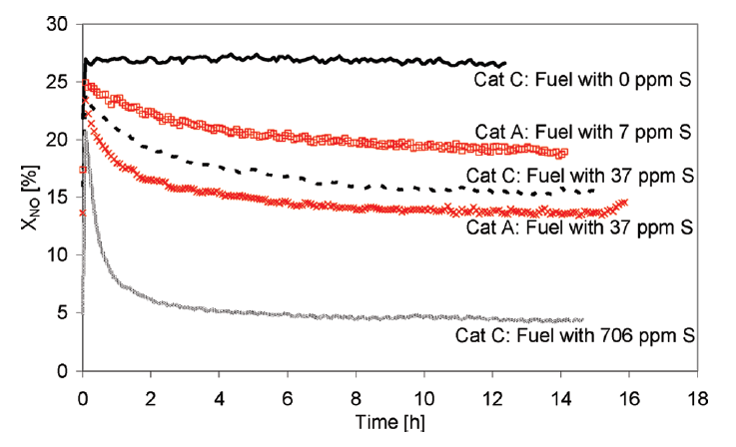
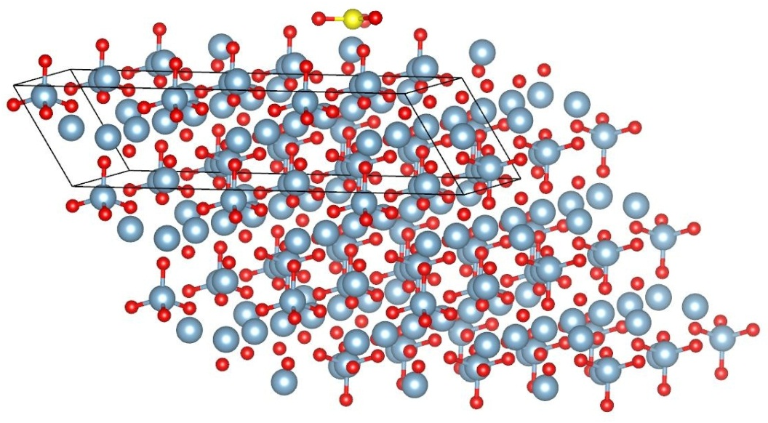
DOC deactivation due to sulfur
Support sulfation
Metal oxide sulfation

Slide 32

Acknowledgments
DOE GAANN fellowship and Pre-doctoral fellowship
Prof. Pu-Xian Gao for Pt/ZnO monolith
Group members: Molly Koehle
Venkatesh Botu
Ameya Akkalkotkar

